Slide 1


Introduction to Segmentation
Thresholding in FIJI: Image Processing, Step 1
Zafar Nurmatov, 2026

Slide 2
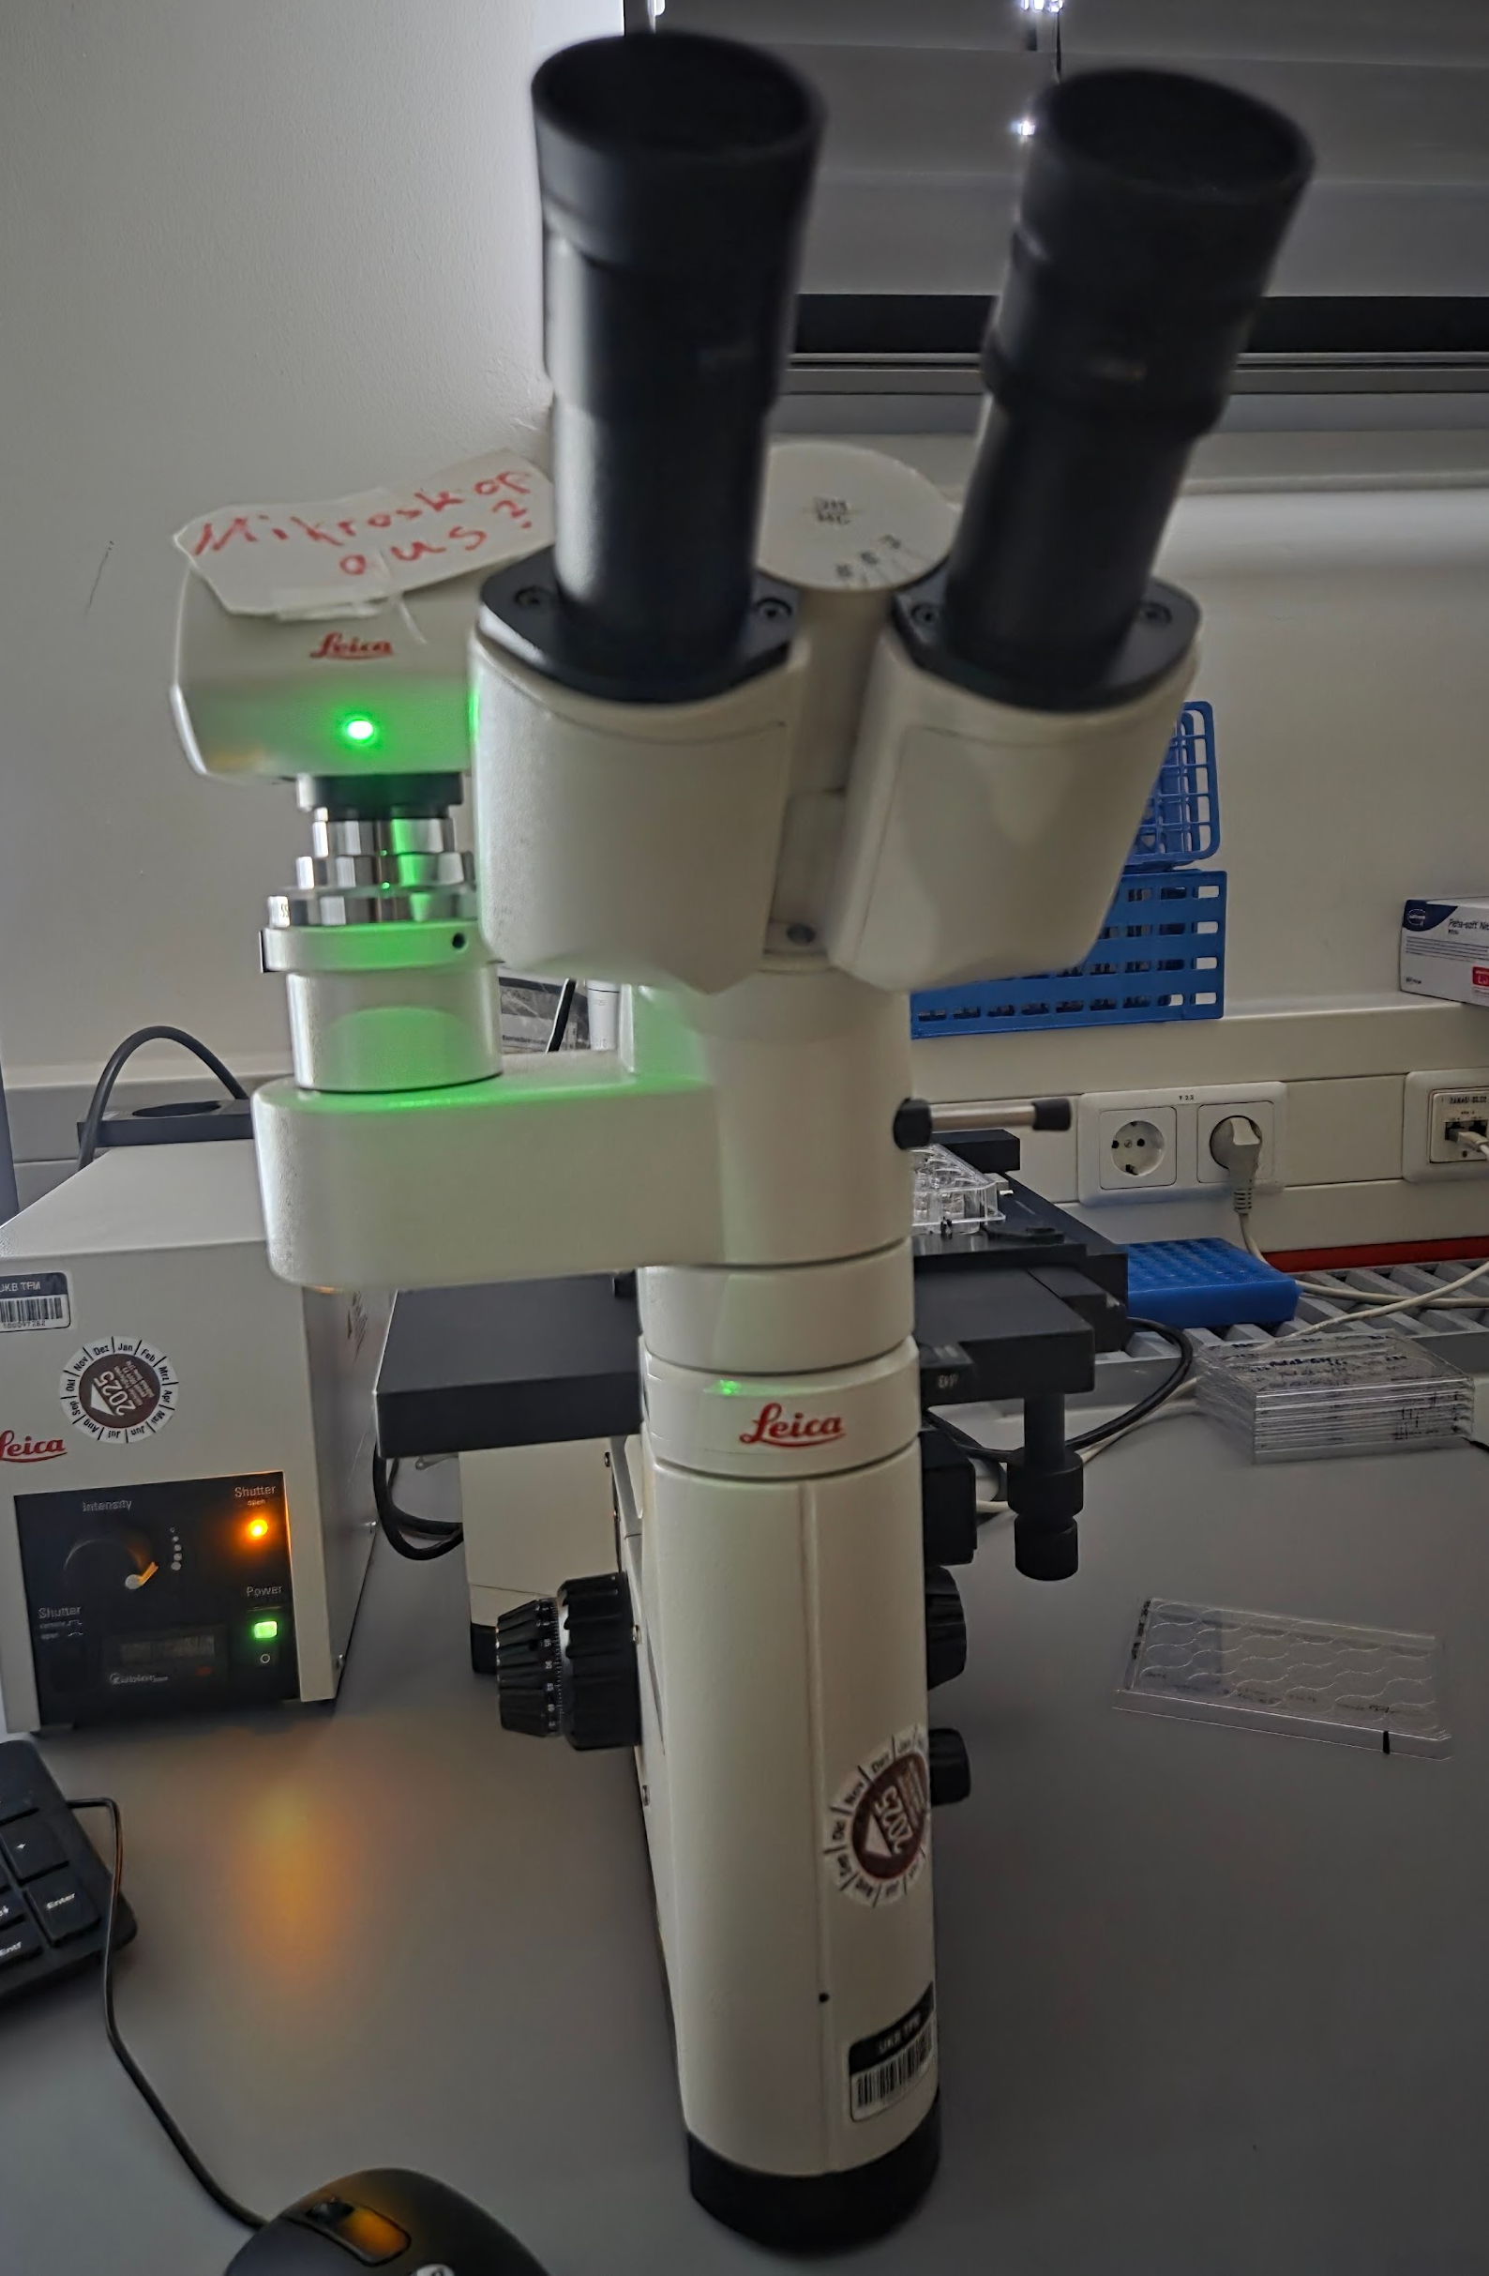
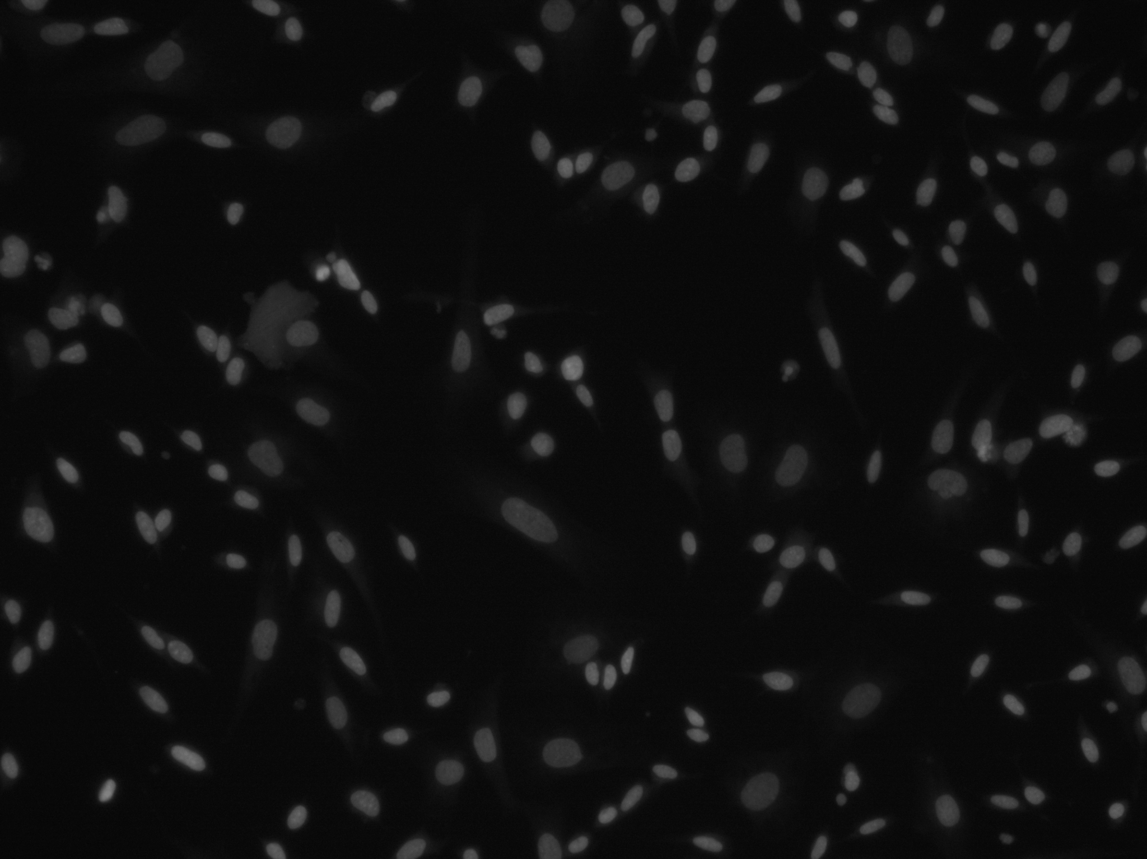
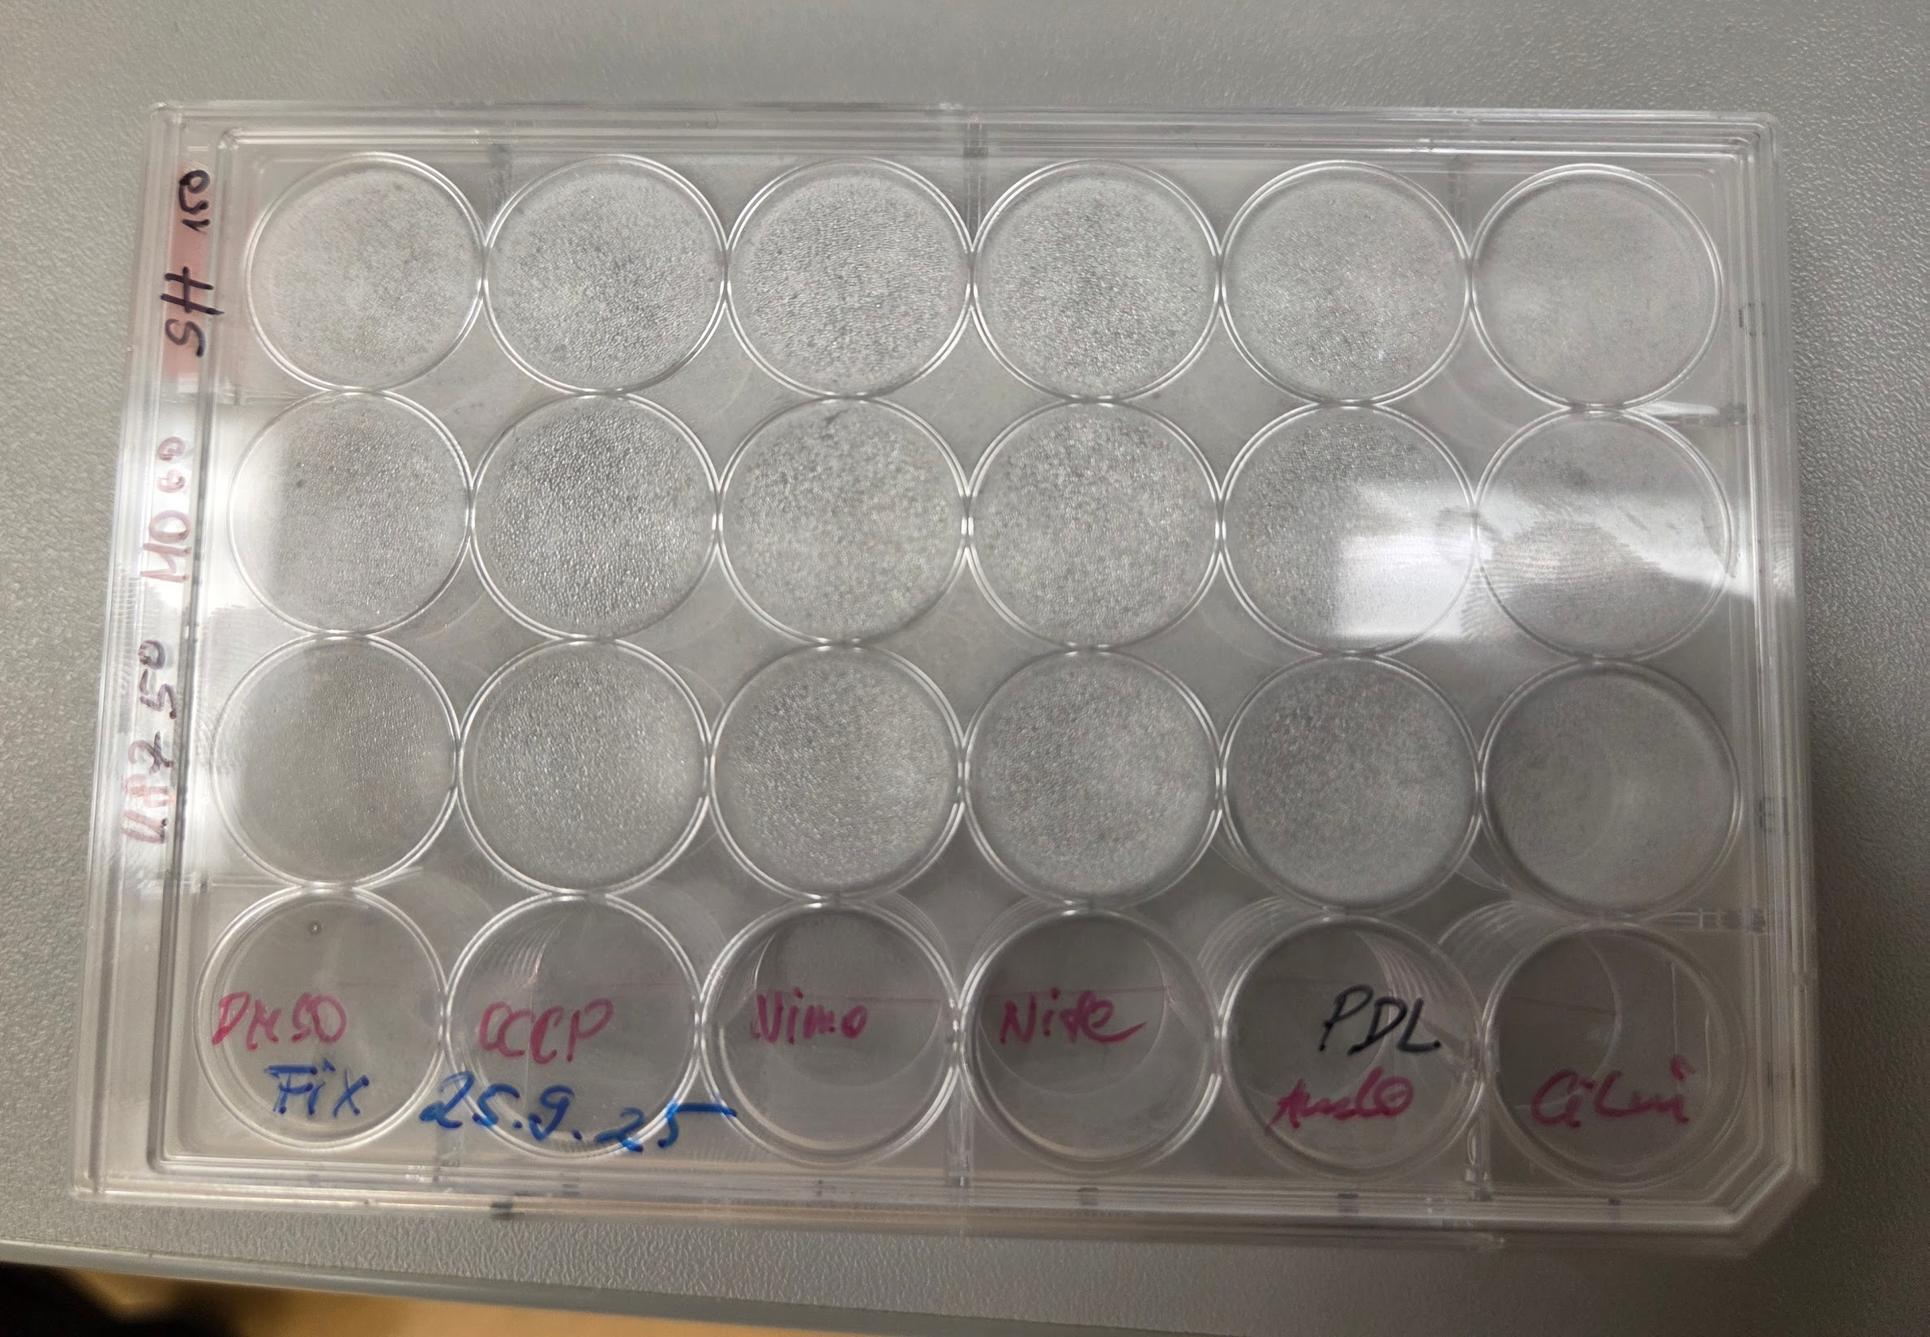
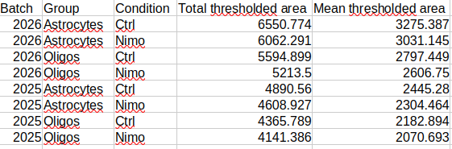
2D Fluorescence Microscopy, Workflow
Image Acquisition
Samples
Images
Data
Data Analysis
Image Processing

Slide 3
Image Processing
Despite the variety of workflows and scenarios, the first, or one of the first steps in image processing is segmentation
Segmentation: separation of cellular objects from the background into groups
There are different types of (automatic) segmentation algorithms, each of which is based on a particular principle.
In contrast, manual segmentation refers to manual outlining of cellular objects of interest from the background. When comparing against manual segmentation, various segmentation algorithms yield variable and somewhat inaccurate results, which can impact downstream processing. [Ref. 2]
As it turns out, the method oftentimes closest to manual segmentation was a single global threshold determined in advance by the expert.
Thresholding Assistant: a Fiji Macro to support the user in determining this global threshold value

Slide 4
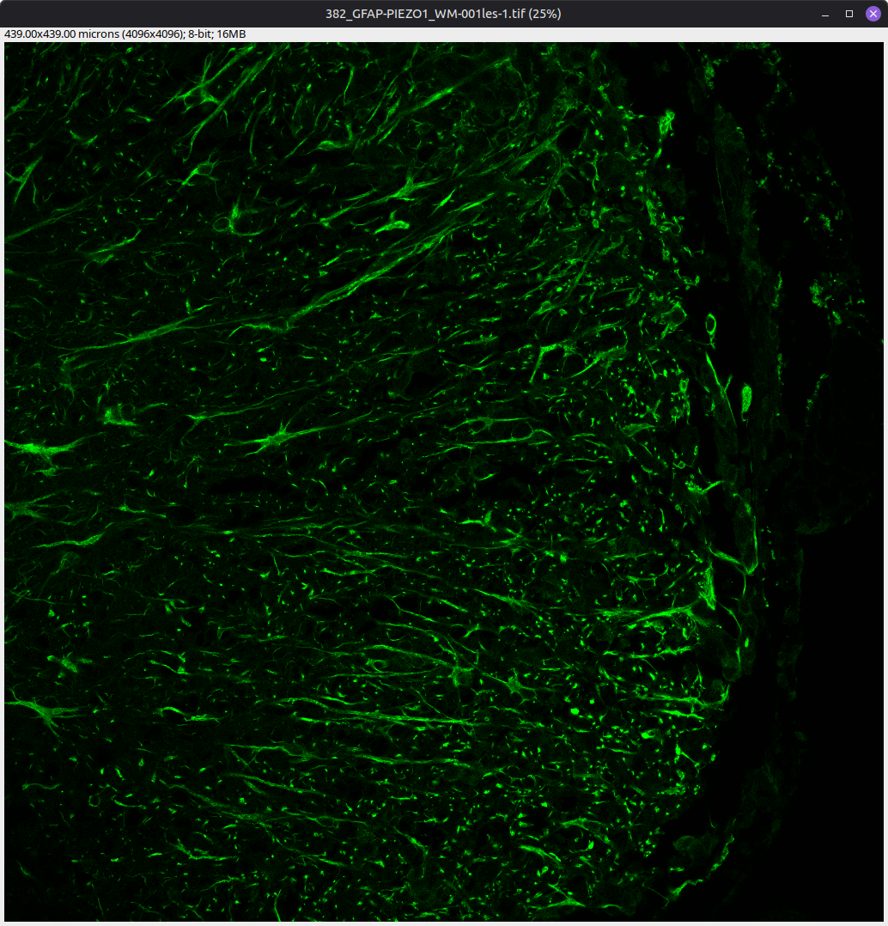
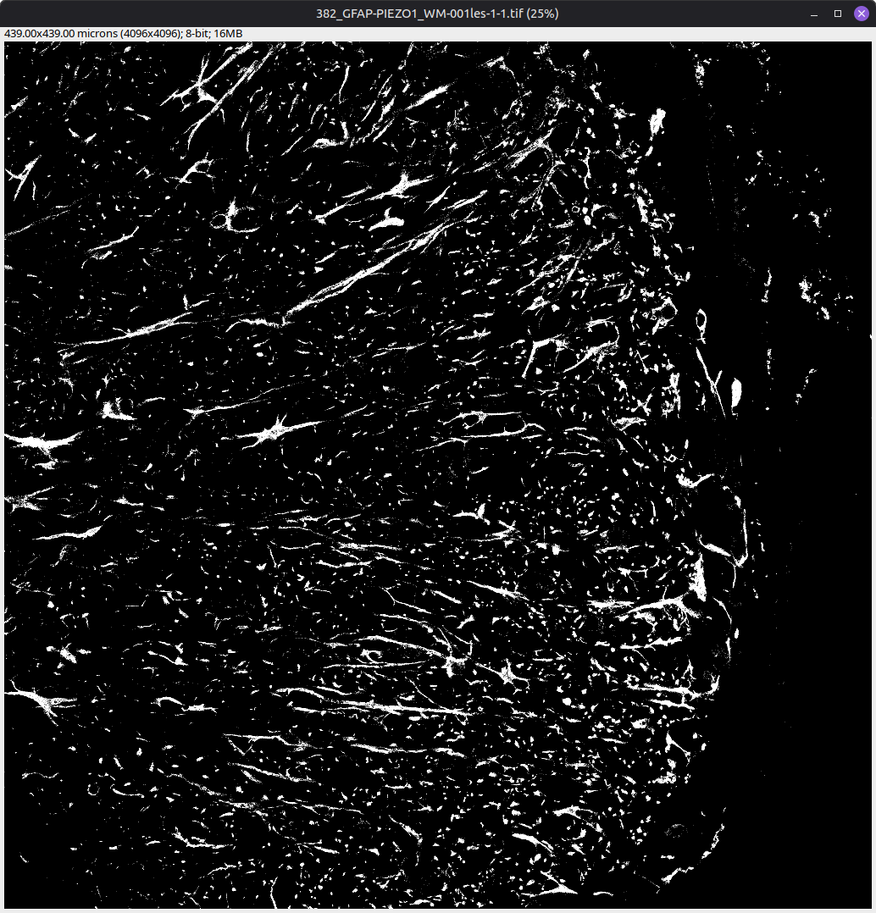
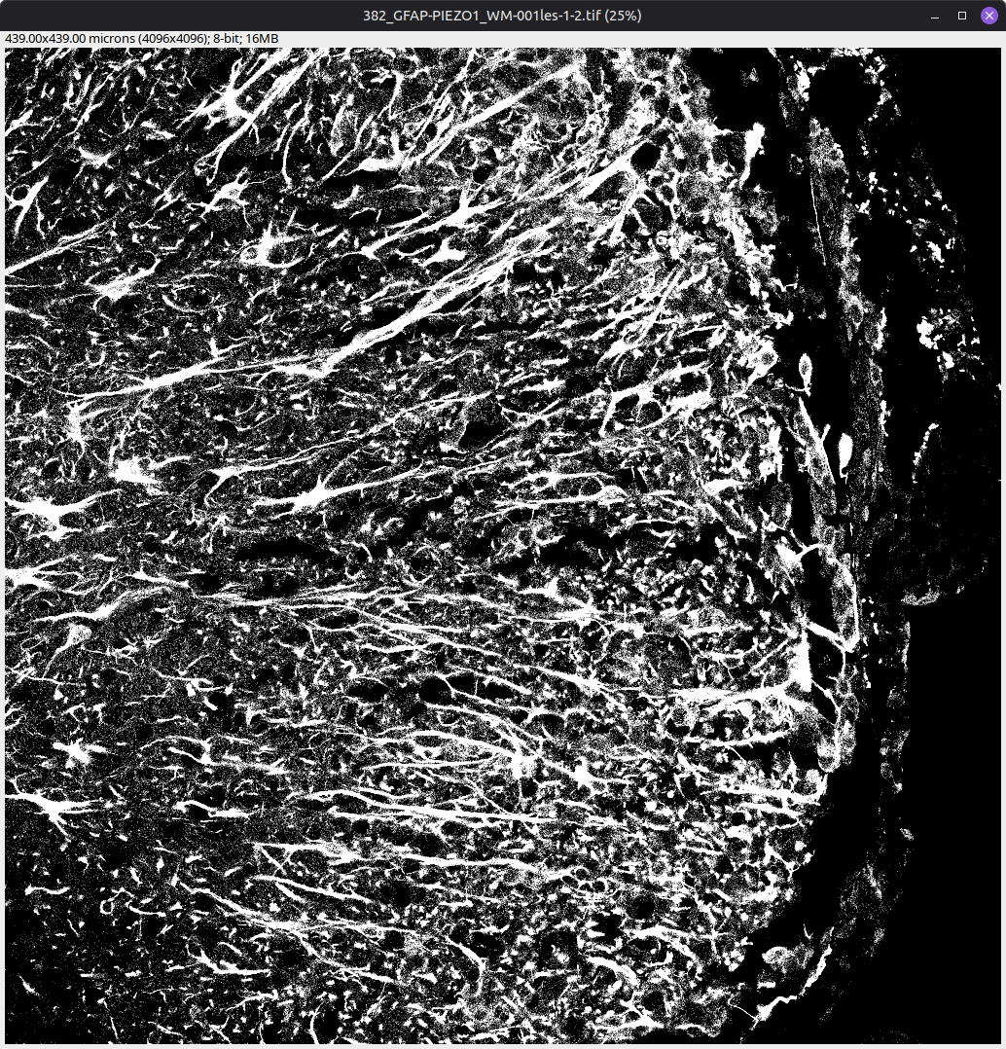
Automatic Segmentation in Action 1/2
Original
Otsu
Huang

Slide 5
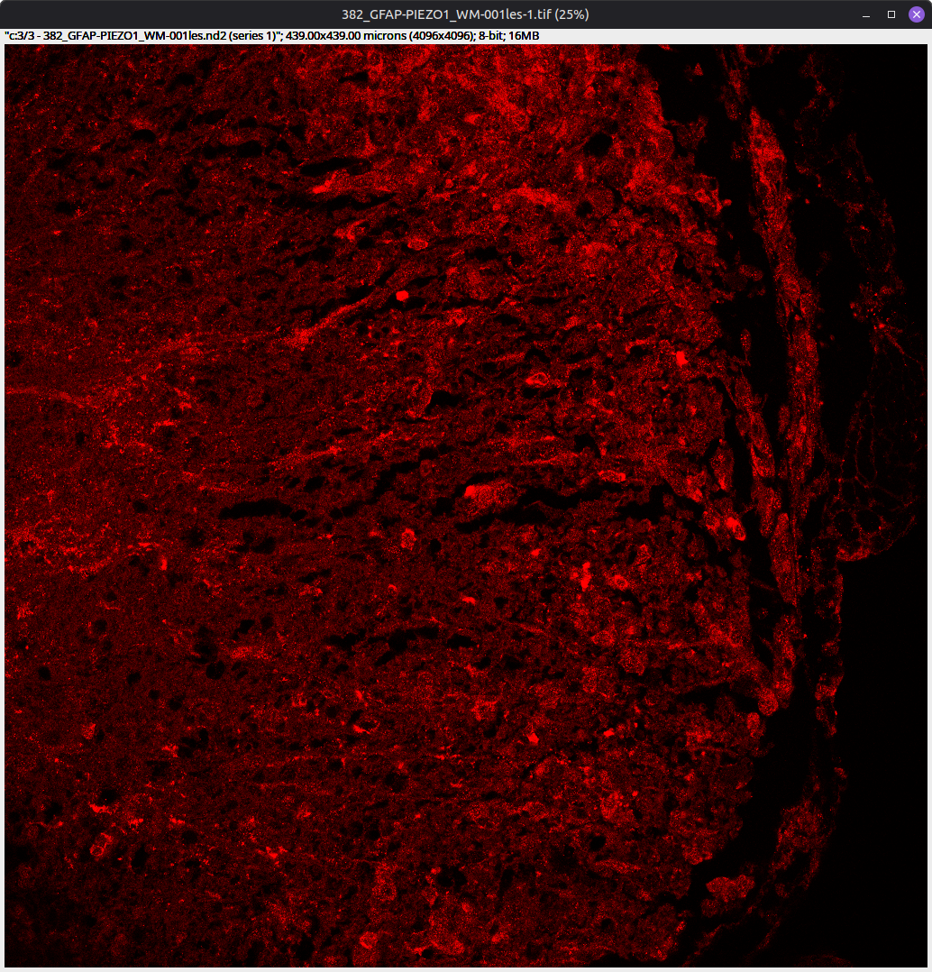
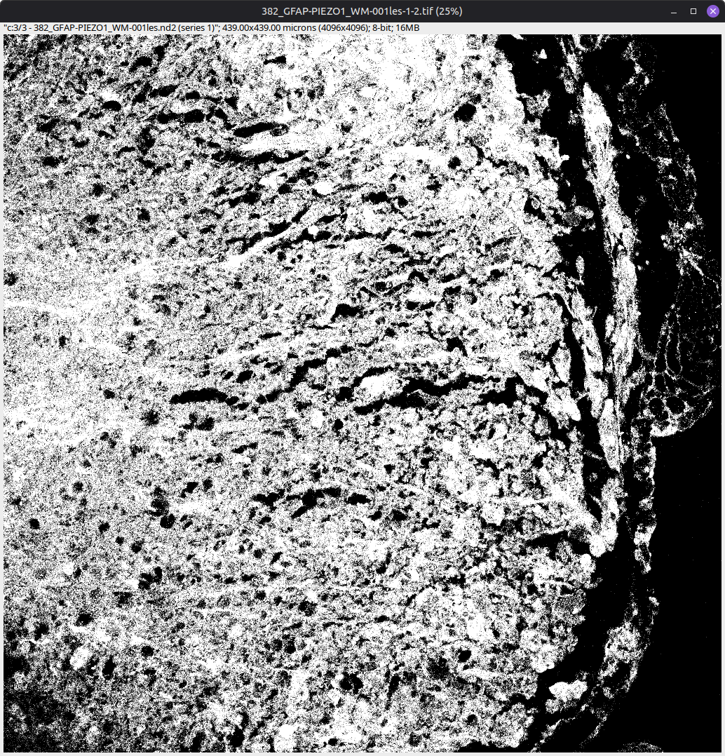
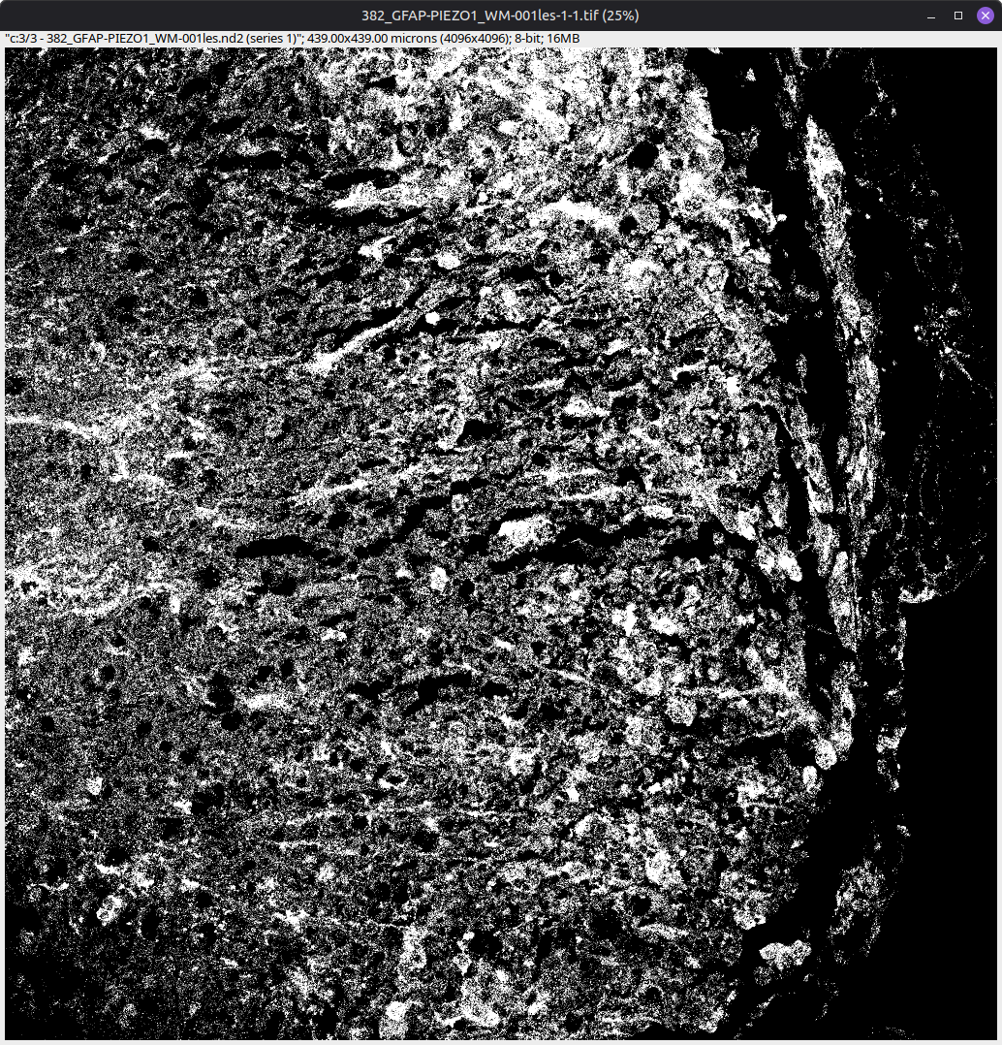
Automatic Segmentation in Action 2/2
Original
Otsu
Huang

Slide 6
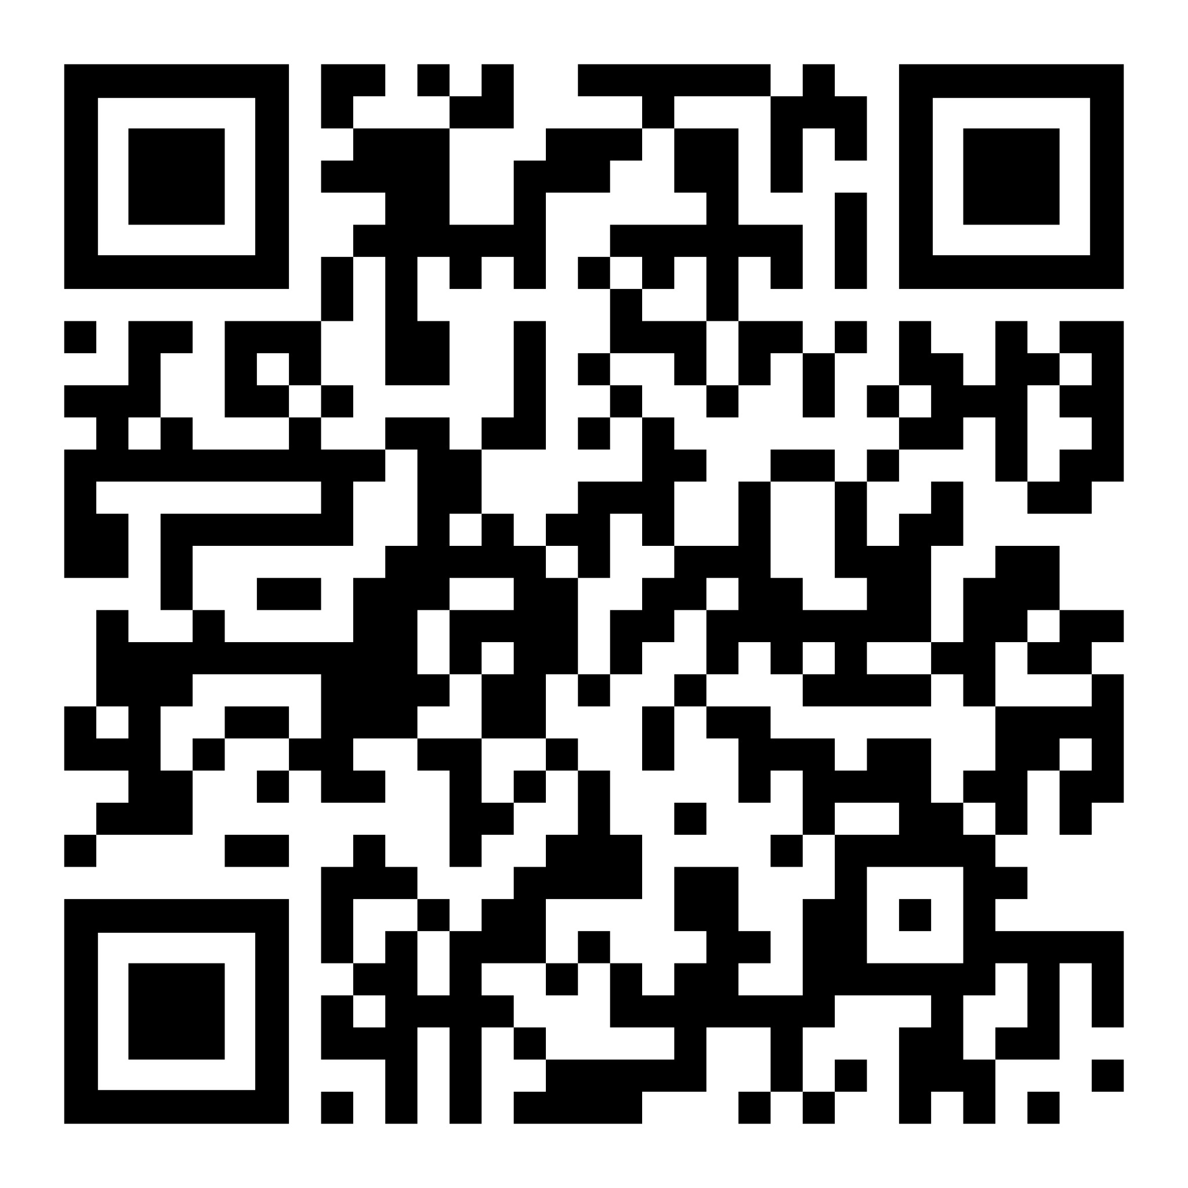
Fiji and the “Thresholding Assistant” Macro
What is Fiji?
Fiji is an image processing package. Why use Fiji?
Free and open source
Easy to install and use
Available on most operating systems
Bundled with a lot of preinstalled plugins
Has extensive documentation
Why use this script?
It streamlines the discovery of valid threshold values
The macro is accessible and easy to use
May help to find the proper balance between time and accuracy

Slide 7
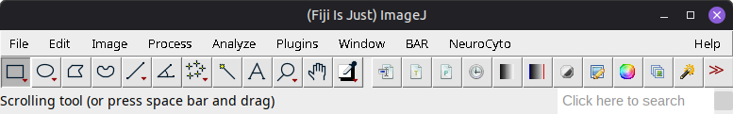
How to run the macro 1/2
Part 3
Download the macro
Open Fiji
Press “Plugins” (in red)
Click on “Macros”
Press “Run”
Select the macro in the pop-up window

Slide 8
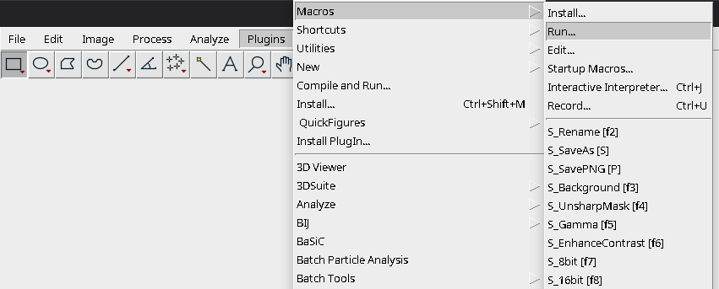
How to run the macro 2/2
Part 3
Download it
Open Fiji
Press “Plugins”
Click on “Macros”
Press “Run”
Select the macro in the pop-up window
After that, the macro will run and the first dialog window will appear (see the next slide)

Slide 9
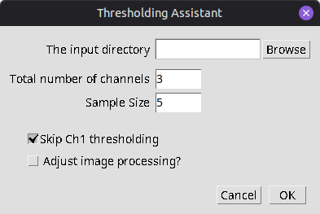
Dialog 1: Basic setup
Select folder with .tif images (input directory).
Provide the number of channels in the images. This value is set to 3 by default.
Sample Size: how many randomly selected images would be representative of the entire collection of images? This value is set to 5 by default, but it is recommended to increase it to 7-10.
Check the “Skip Ch1 thresholding” box if it is not necessary to estimate Ch1 threshold (Channel 1 being a reference/structural channel)
“Adjust Image Processing?” needs to be chosen to alter the processing pipeline!

Slide 10
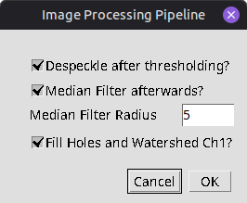
Dialog 2: “Adjust Image Processing?”
Image Processing after Thresholding
Part 4
The built-in image processing workflow consists of the following steps:
Threshold -> Despeckle -> Median Filter -> Fill Holes -> Watershed
Each of these operations is optional (except thresholding) - see the following slides for illustrations
Threshold: segments the image into foreground and background
Despeckle: removes small particles from the foreground
Median Filter: removes noise and preserves edges
Channel 1-specific operations:
Fill Holes: if there is a ring-like particle, e.g. whose rim pixels have higher intensity than the center pixels, then everything within the ring will be also be counted as particle
Watershed: separates aggregated, clumped particles
Click on “OK” to confirm the settings and start estimating the thresholds!

Slide 11
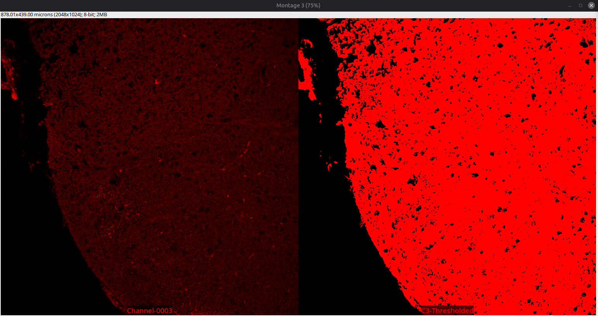
Macro 3/6
1. Inspect the automatically estimated threshold - it might be needed to move the “Montage” windows to view each channel independently

Slide 12
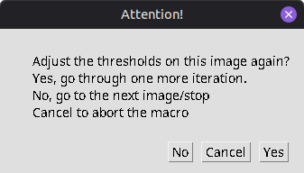
Macro 3/6
1. Inspect the automatically estimated threshold - it might be needed to move the “Montage” windows to view each channel independently
2. If it seems necessary to adjust the threshold, click “Yes”

Slide 13
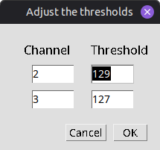
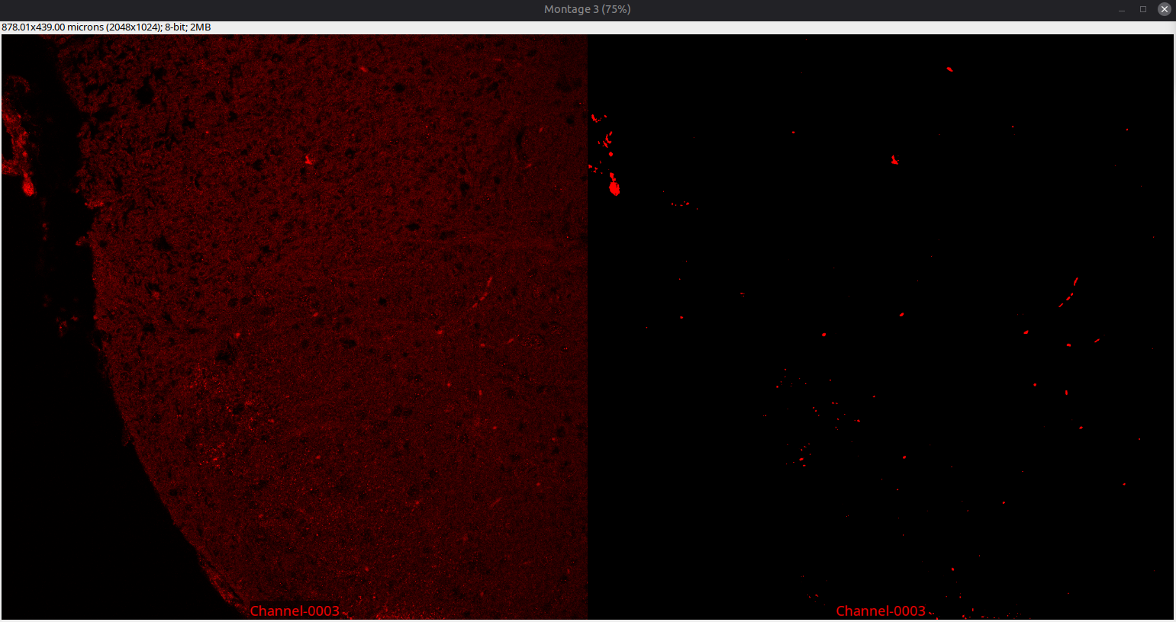
Macro 4/6
3. Change the values accordingly and click “OK”
5. Click on “Yes” to iterate one more time, or click on “No” and move on to the next sample image
4. Inspect the new estimate

Slide 14
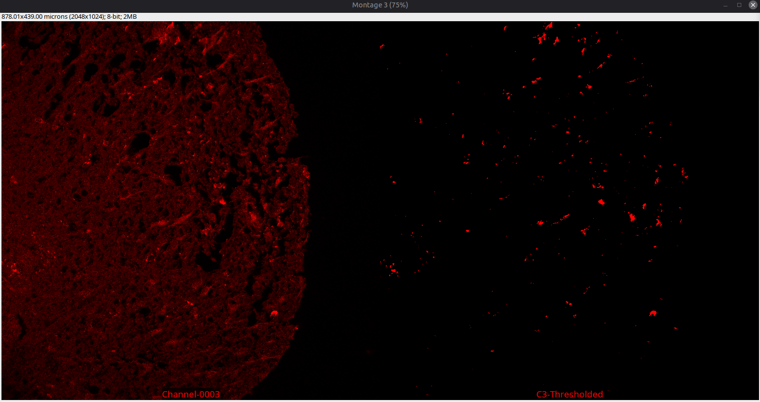
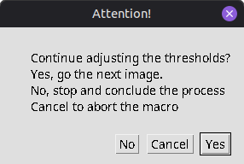
Macro 5/6
As the number of sampled images is still low, it is reasonable to inspect more images

Slide 15
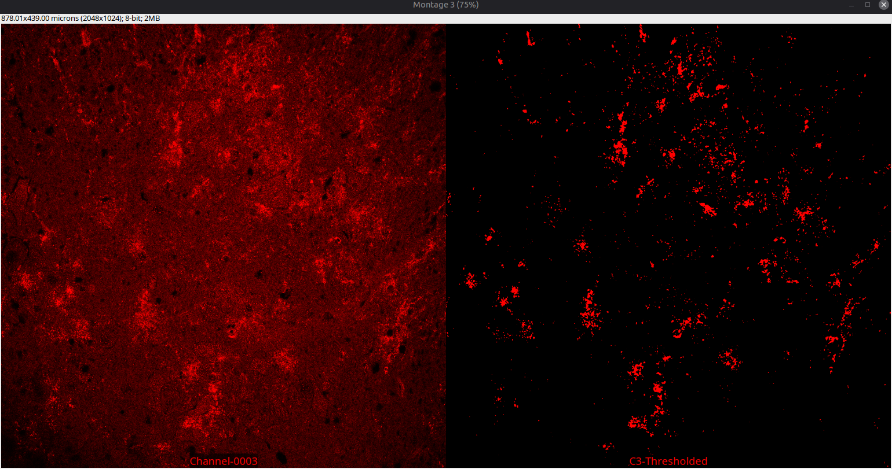
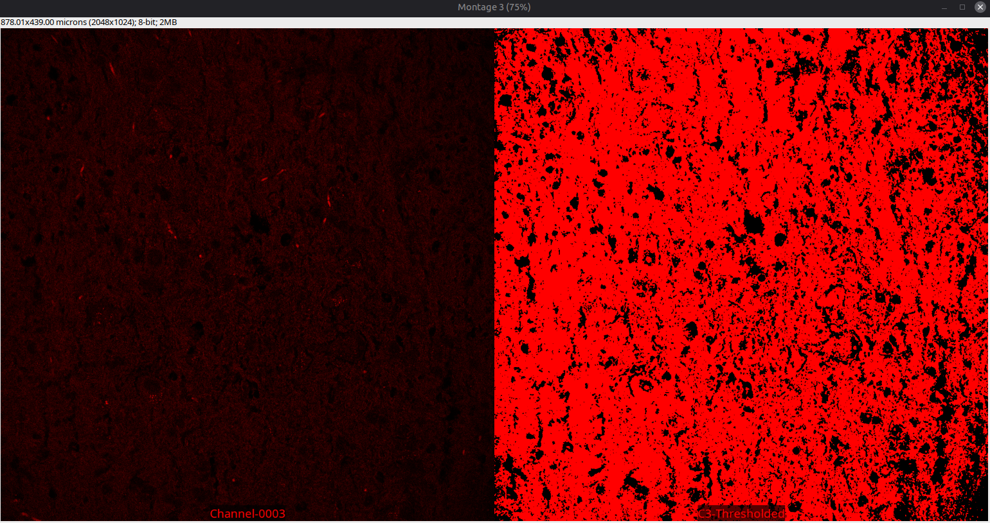
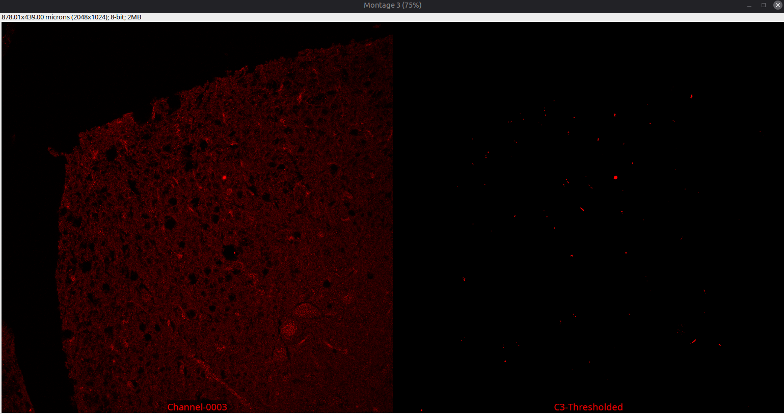
Macro 6/6
After being done with estimating the thresholds, click on “No” in the pop-up window

Slide 16
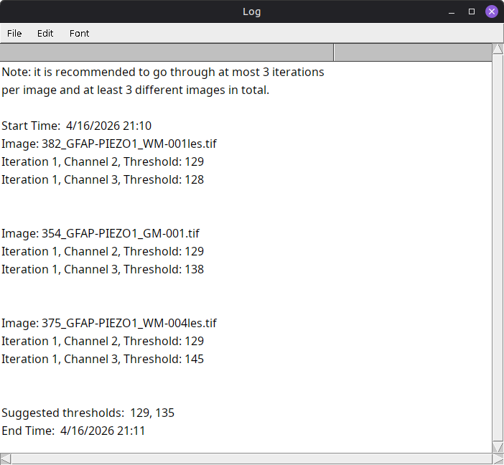
Session Information
Saved as a .txt file to the output folder
Timestamps
Images
Iterations
Channels
Thresholds
Suggested thresholds
For easier tracking, troubleshooting and reporting

Slide 17
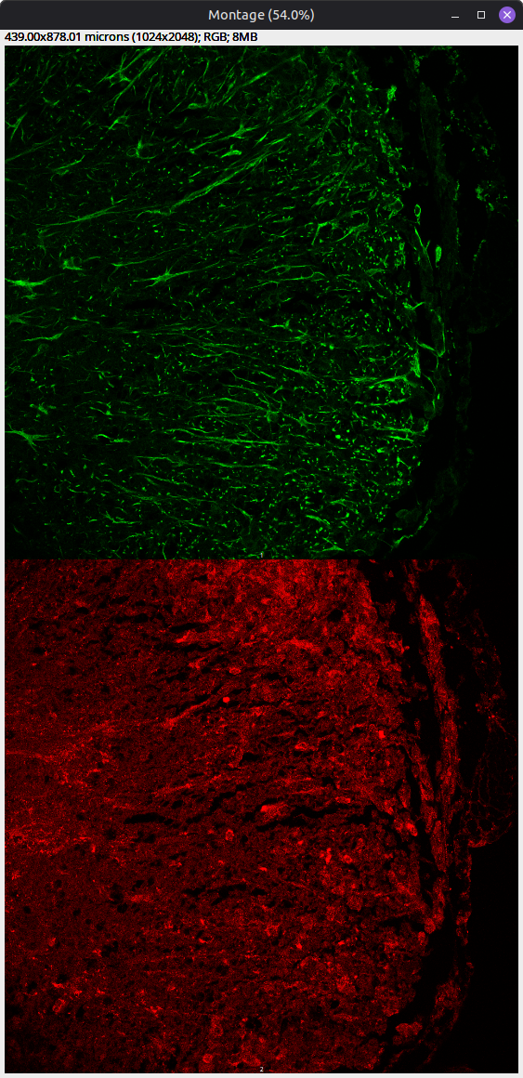
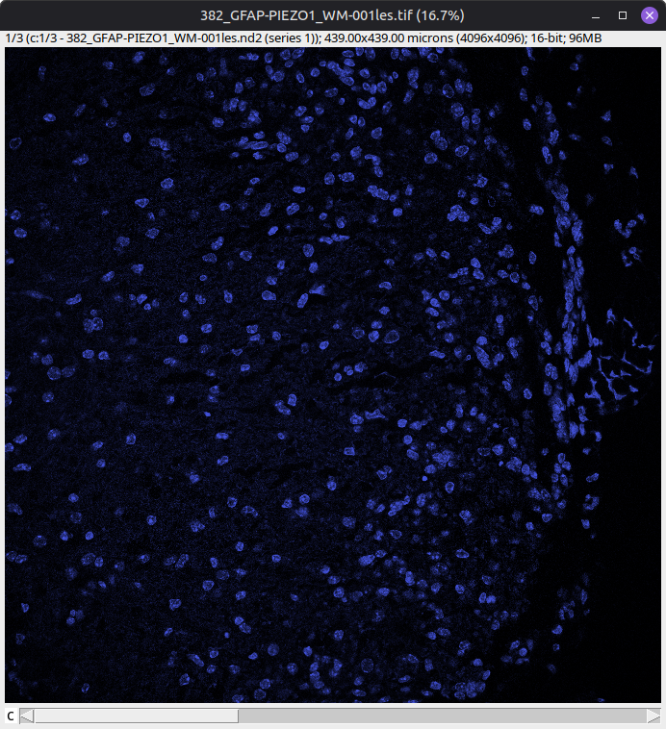
Processing 1/5
Split Channels 2,3
Downsample to 8-bit

Slide 18
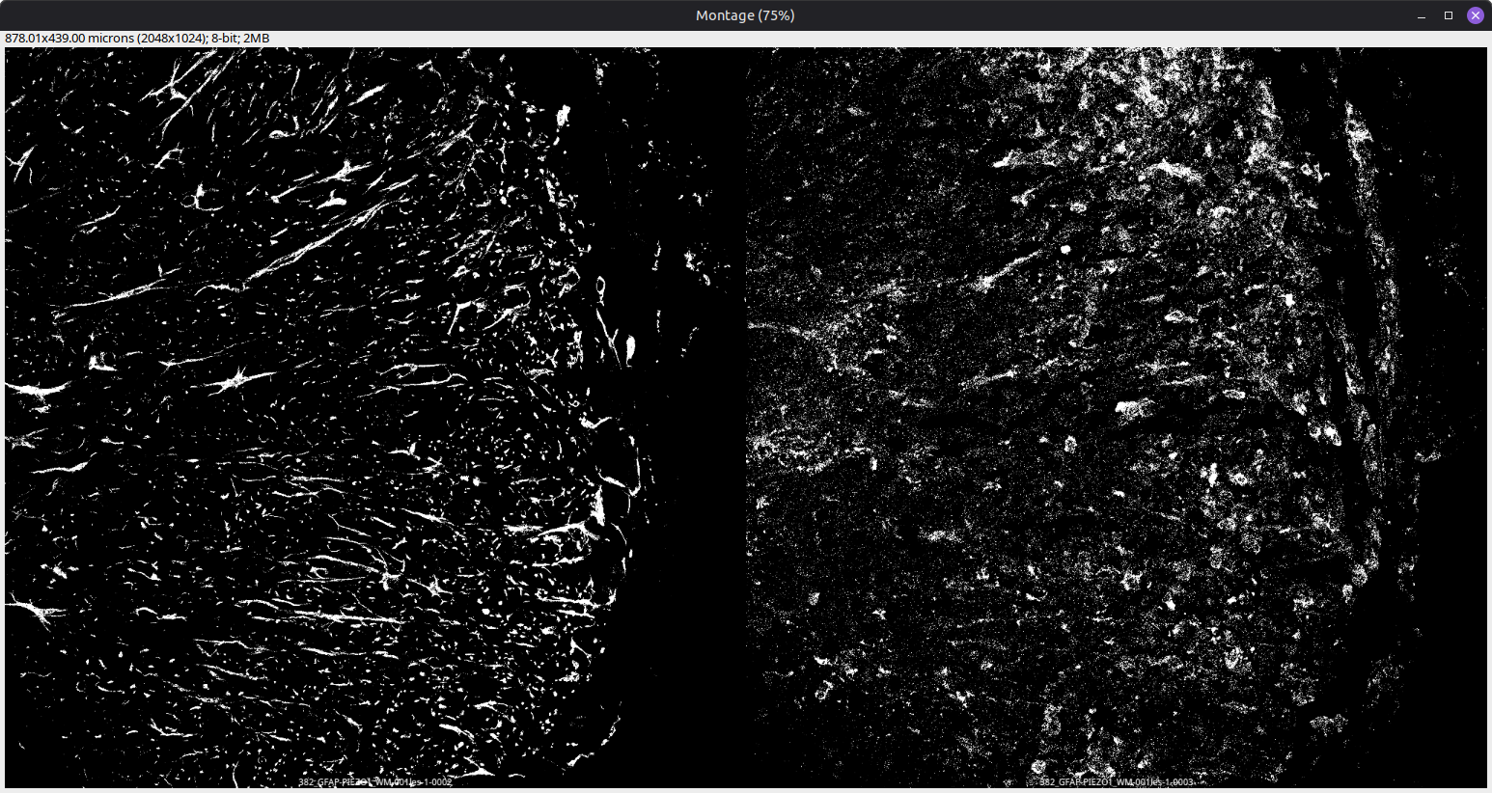
Processing 2/5 - Threshold
GFAP
Piezo1

Slide 19
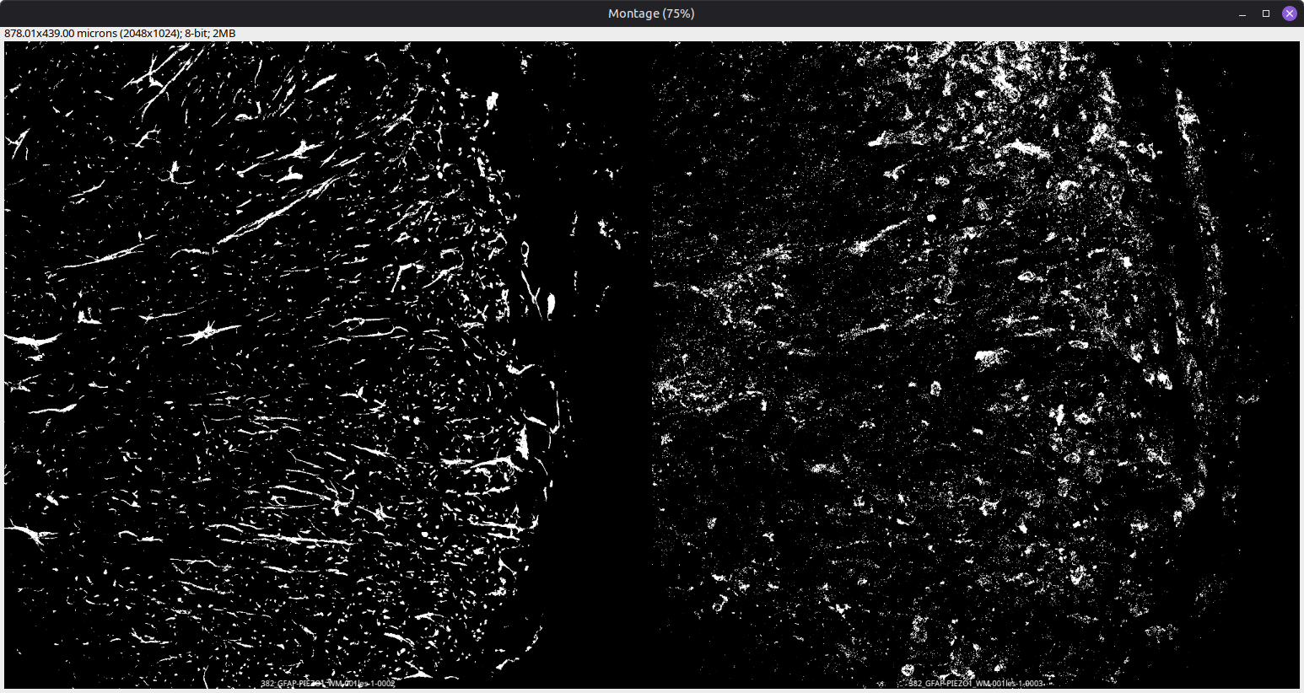
Processing 3/5 - Despeckle
GFAP
Piezo1

Slide 20
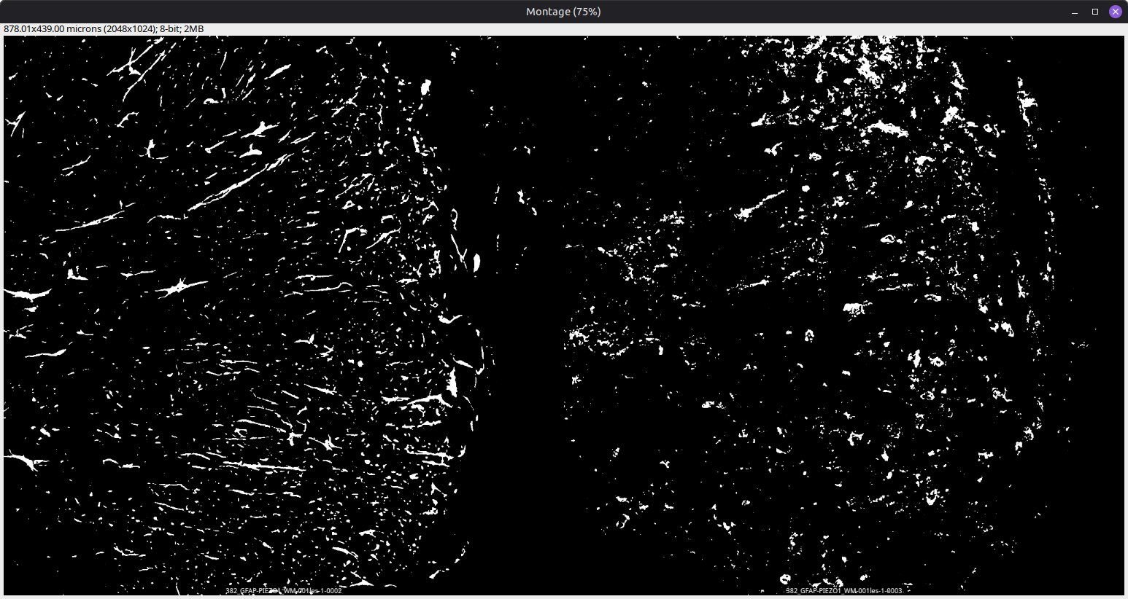
Processing 4/5 - Median Filter
GFAP
Piezo1

Slide 21
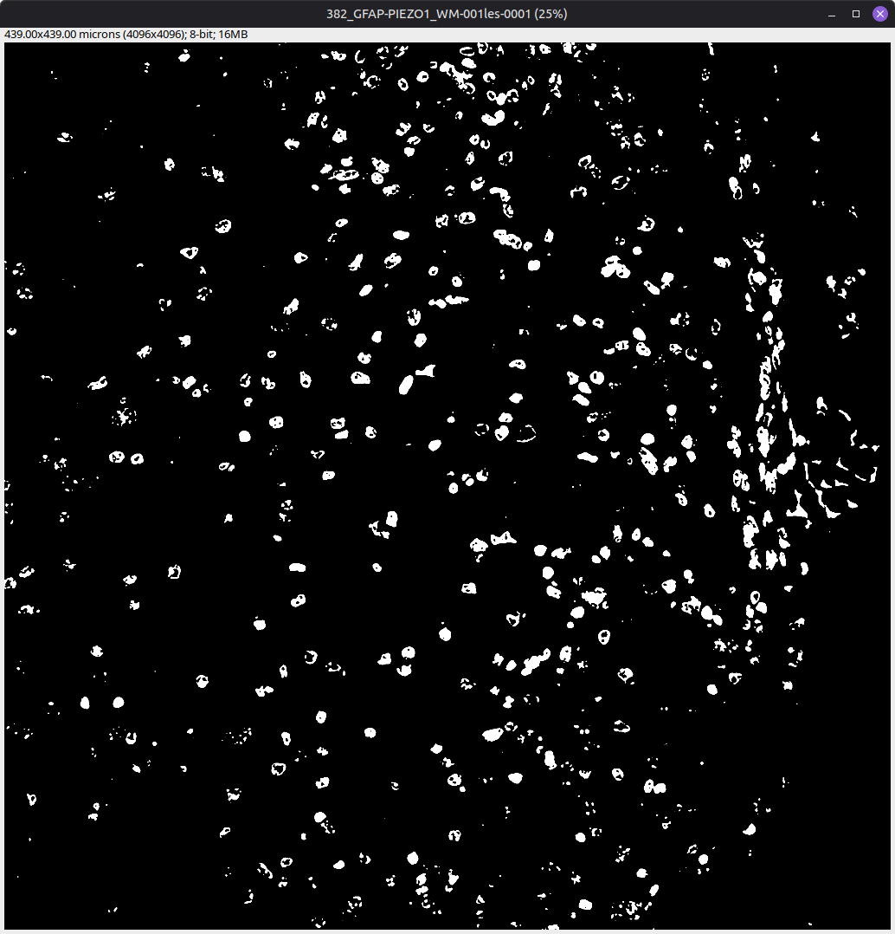


Processing 5/5 - Channel 1 (Optional)
Is there any Ch1 Processing at all? If yes, and all previous steps have been completed
Fill Holes
Watershed

Slide 22
What’s next?
References
The estimated thresholds can be used in other macros or plugins requiring pre-defined values for image segmentation
Schindelin, J., Arganda-Carreras, I., Frise, E. et al. Fiji: an open-source platform for biological-image analysis. Nat Methods 9, 676–682 (2012)
Dima, A.A., Elliott, J.T., Filliben, J.J. et al. Comparison of segmentation algorithms for fluorescence microscopy images of cells. Cytometry, 79A: 545-559 (2011)

